Slide 1
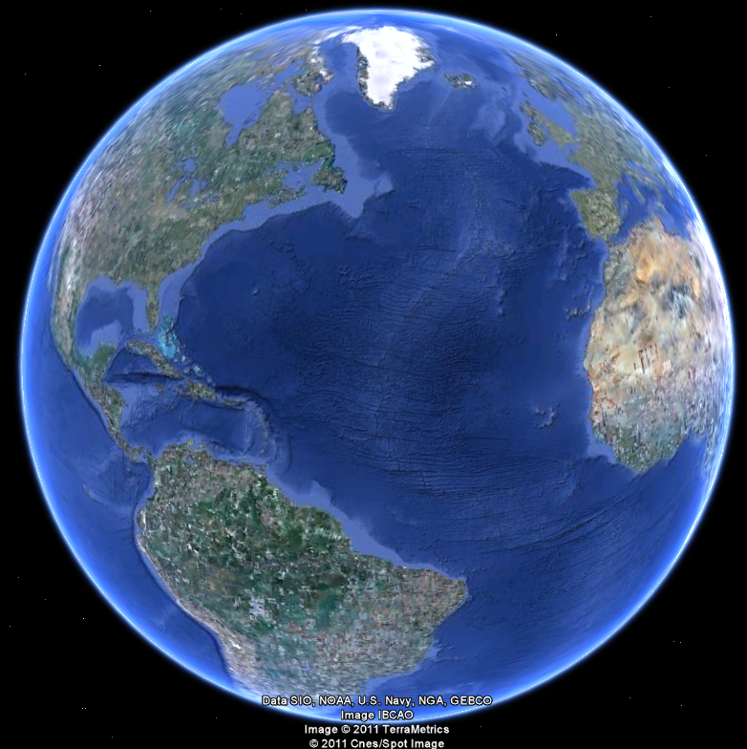
APEC 100 Sustainable Development
Strategic Conservation

Slide 2
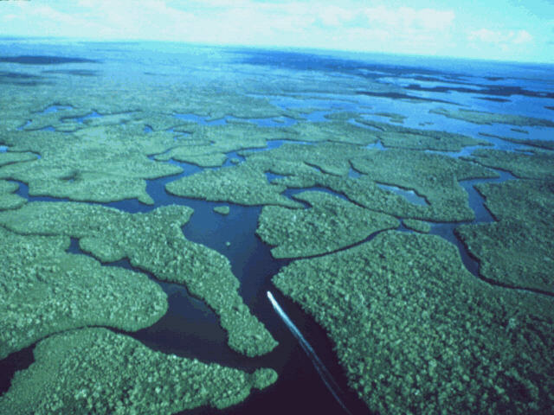

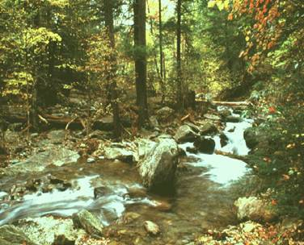
Changing Face of Conservation: Focus on Environmental Services
Examples
Wetlands for water filtration and flood prevention
Trees and forests to cleanse the air
Carbon sequestration
Salt marshes for wildlife habitat and storm surge prevention
For these examples, there are multiple opportunities to invest funds and what matters is the on-the-ground realities.
Notes:
www.khammamrealty.com

Slide 3
Applying Evidence-Based Policy
Markets are powerful and de-centralized. With careful design, they can help improvement environmental outcomes.
Develop optimization tools to improve the public investment in conservation services.
Educate (and persuade) government and nonprofit leaders to use these tools.

Slide 4
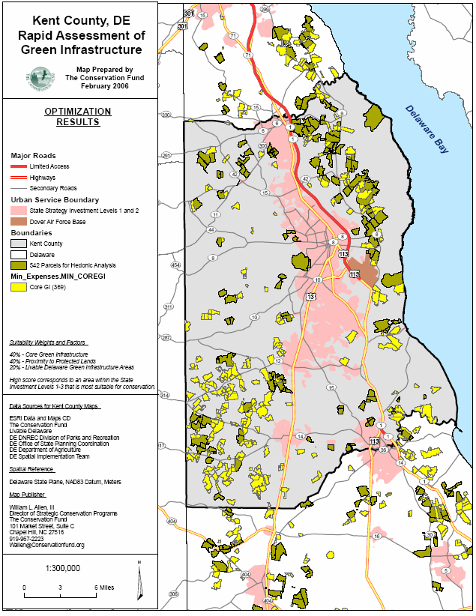
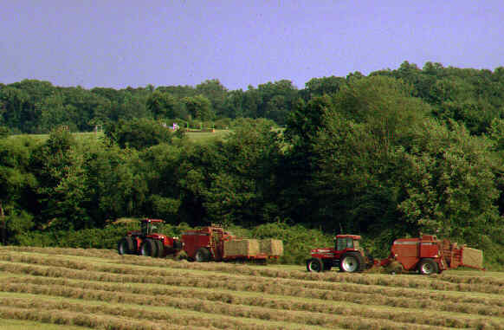
The Power of Markets
Agricultural preservation in Delaware
Founded in 1991, annual market where winners are determined by the percentage of ‘discounting’ off development rights.
Discounting is the “percentage off” the appraised value.
60% discount of a $1m farm means government pays farmer $400,000.
Creating markets helped Delaware protect an additional 25,000 acres in first decade.
67,834 acres instead of just 42,852 acres
Source: Messer and Allen (2010)

Slide 5
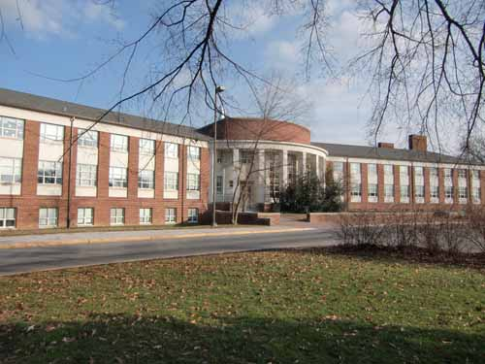
Designing the Cost-Effective Conservation Markets
Laboratory for Experimental & Applied Economics
025 Townsend Hall
Funding Support
Delaware Department of Agriculture
Environmental Protection Agency
National Atmospheric and Oceanic Administration
National Science Foundation
State of Delaware
US Department of Agriculture

Slide 6
Improving Selection What is environmental project selection most like?
Buying wine?
(Improvements in benefits can cost lots more money)
Buying beer?
(Improvements in benefits costs a little more money)
Finding true love?
(Improvements in benefits are free)

Slide 7
Improving Selection
Last Great Places
(Benefit Targeting)
Invests in highest ranked projects until the budget is expended.
Optimal, only if all costs are equal.
Large efficiency problems if there are high quality substitutes at a lower price.
Best On-the-Ground
(Optimization)
Maximizes aggregate conservation benefits given budget constraint
Invests in “Best Buys” that provide high quality at a lower price.
Excellent for environmental services

Slide 8
Improving Selection
If the State of Delaware had used optimization with its market it could have protected an additional 12,000 acres (worth $25-40 million).
Benefit Targeting: 42,852 acres
Market: 67,834 acres
Market + Optimization: 79,178 acres
… 36,000+ acres of high quality agricultural land preserved
Source: Messer and Allen (2010)

Slide 9
Lorenz Curve Analysis

Slide 10
Lorenz Curve Analysis

Slide 11
Lorenz Curve Analysis

Slide 12
Lorenz Curve Analysis

Slide 13
DALPF Historical Analysis 1996-2007 (Estimated benefits $25-40 million)

Slide 14

USDA Forest Legacy Program
The Forest Legacy Program works in partnership with States to protect environmentally sensitive forest lands.
82 possible projects that are being considered for 2009 funds with a budget of $53 million.
Panel of ten experts rated each project and provide a numeric score (the highest and lowest scores were excluded).
Optimization could have helped them protect an additional 91,621 acres in the first year for the same budget.

Slide 16
Results

Slide 17

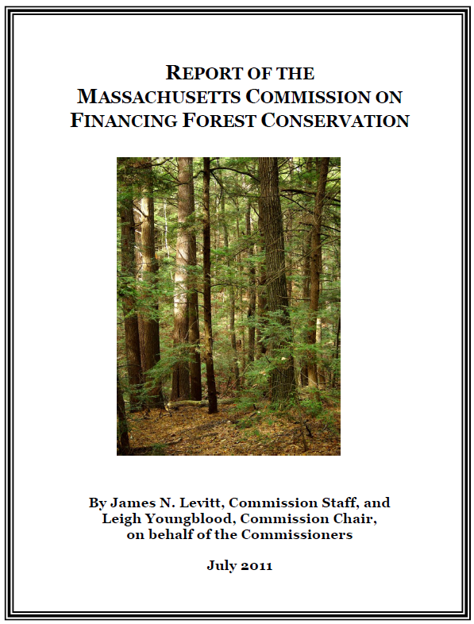
Application of Optimization in Conservation Settings
Applications with The Conservation Fund
Baltimore County, Maryland – Agricultural land protection since 1997.
US Fish & Wildlife and NiSource – Largest multiple endangered species, multiple-state recovery program.
Highway 301 near Waldorf, Maryland – Green Infrastructure
Maryland State Highways Association
Mitigation associated with construction of new ‘Smart Grids’ in the Midwest associated with wind and solar power.

Slide 18
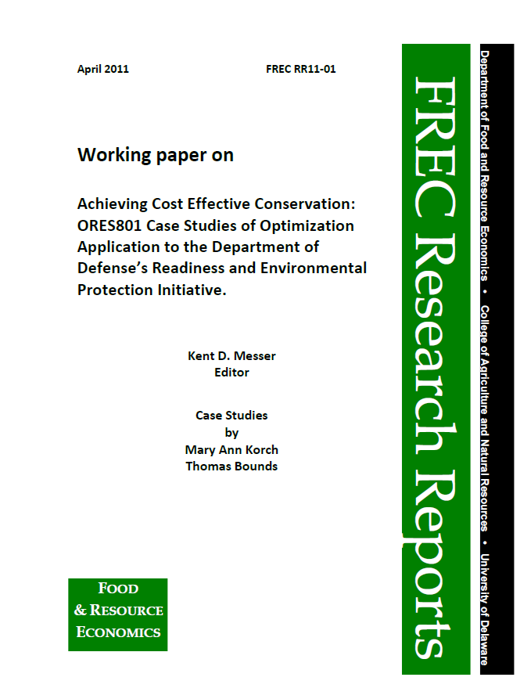
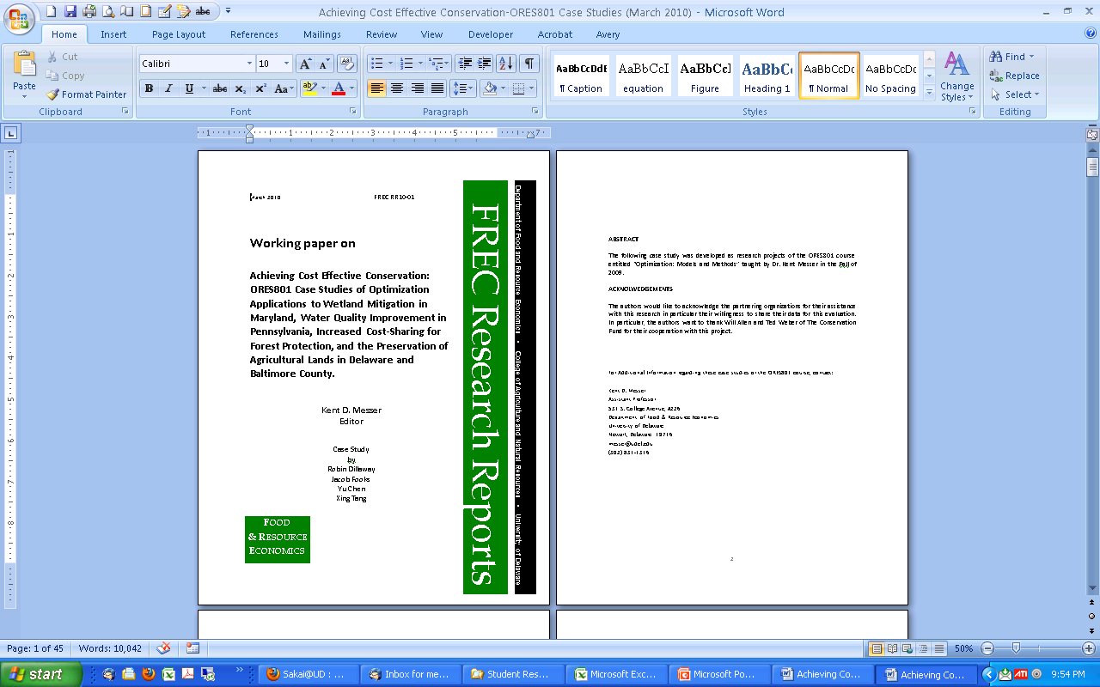
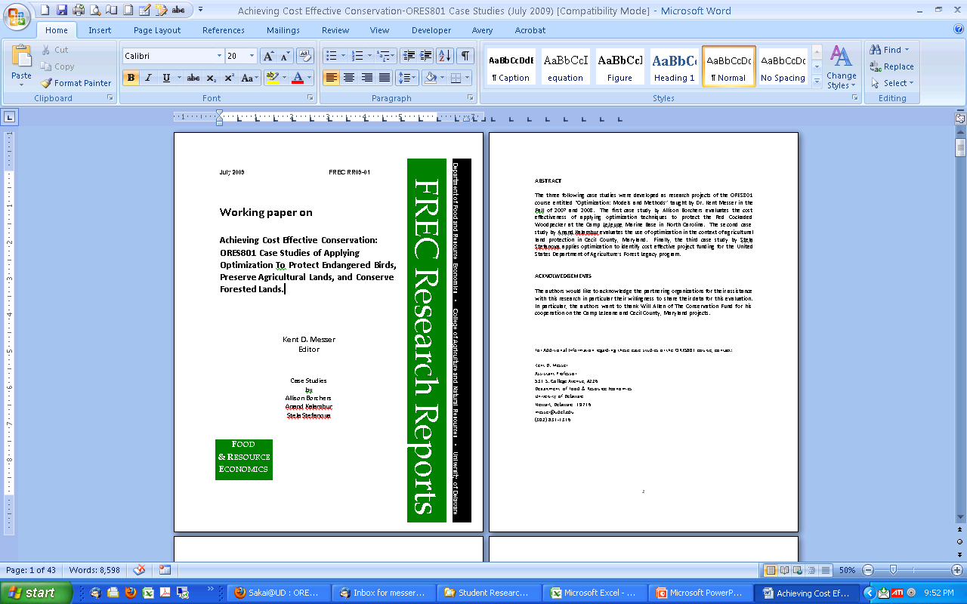
University of Delaware Graduate Student Papers

Slide 19
What federal agency’s land has the most endangered species?
National Park Service
US Forest Service
US Department of Defense
US Bureau of Land Management
U.S. Fish and Wildlife Service

Slide 20
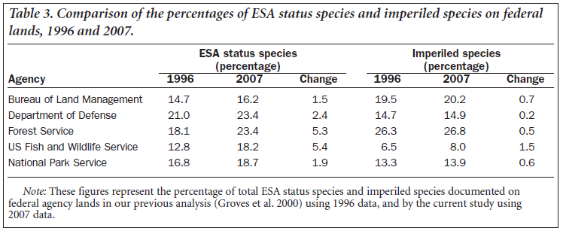
Endangered Species on Federal Lands
Source: “Federal Lands and Endangered Species: The Role of Military and Other Federal Lands in Sustaining Biodiversity” BRUCE A. STEIN, CAMERON SCOTT, AND NANCY BENTON, 2008.

Slide 21
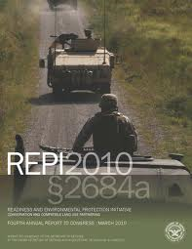
Readiness and Environmental Protection Initiative (REPI)
Office of the Secretary of Defense’s Readiness and Environmental Protection Initiative (REPI)
Fastest growing federal conservation program.
$54 million in 2010.
$100+ million estimated in 2011.
UD report suggests that the benefit for using optimization will exceed $20 million annually.
Could apply the optimization technique of Goal Programming to maximize both the military readiness and environmental protection objectives.

Slide 22
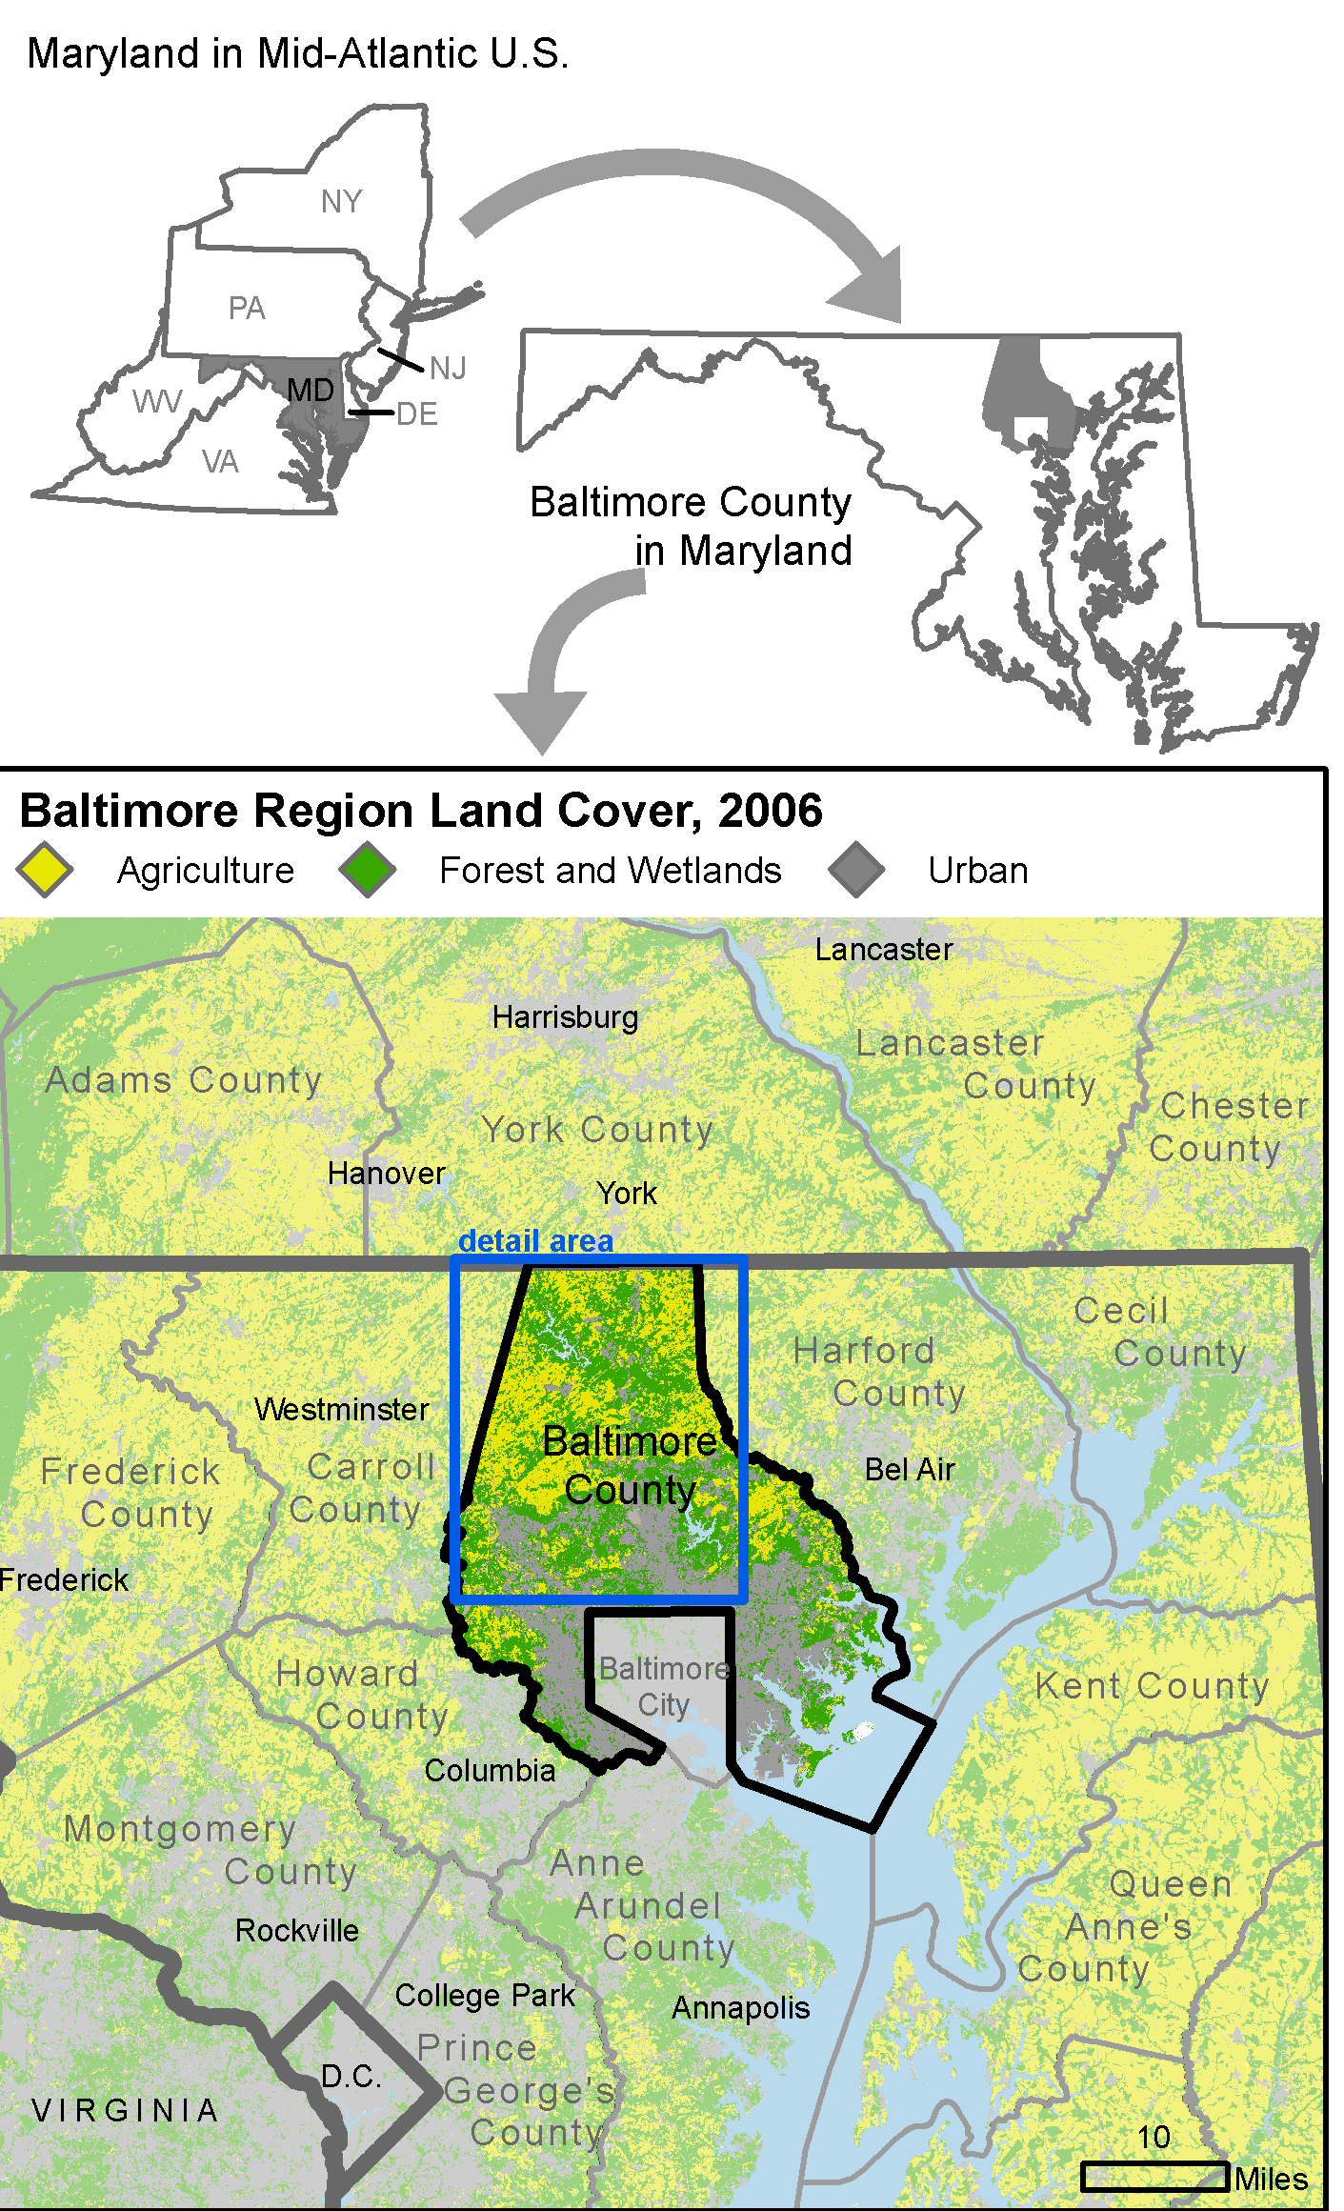
Baltimore County, Maryland
Baltimore County has one of the most well-established farmland preservation efforts in the country, dating back to 1979 .
In 2006, Baltimore County reached a major milestone of preserving 40,000 acres – half of its 80,000 acre goal.
Wanted to apply optimization to improve the use of their limited financial resources while maximizing the return on investment.

Slide 23
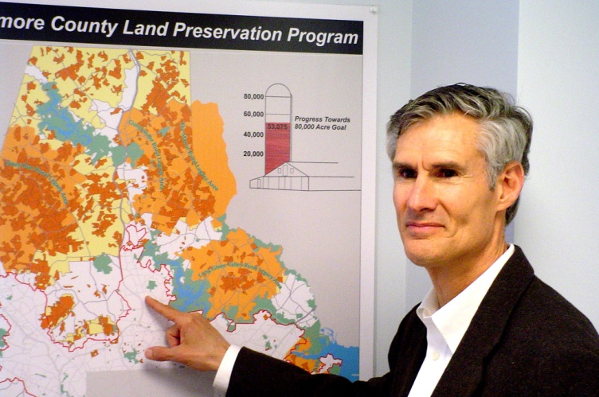

Experience of Baltimore County
2010 amounts: +129 acres
+$932,525
Wally Lippincott, Baltimore County Land Preservation Administrator
"After trying for years to balance price with farm quality using rank based methods, we switched to optimization. In the first three years of using optimization, Baltimore County has been able to protect an additional 680 acres for the same amount of funds that would otherwise have been spent. This also translates into a savings of approximately $5.4 million.”
Rob Hirsch, Baltimore County GIS Analyst
"Optimization has proven easier to administer and run than our old methods. During our rank -based days, we performed extra administrative and mathematical work in order to solicit discounts and award extra LESA points for discounting. With optimization, this is no longer required.”

Slide 24
Optimization as a Planning Tool
At times, it may be best for political or fundraising reasons to purchase the highest ranked parcels
In this case, can optimize with the remaining funds (hybrid approach).
Sensitivity analysis can be done to help evaluate how changes in variables, weights, and/or constraints effect overall selection results.
Training is needed to ensure that staff know how to properly set-up an optimization problem and use the user-friendly software.
Often involves an iterative process (adaptive management and planning)

Slide 25
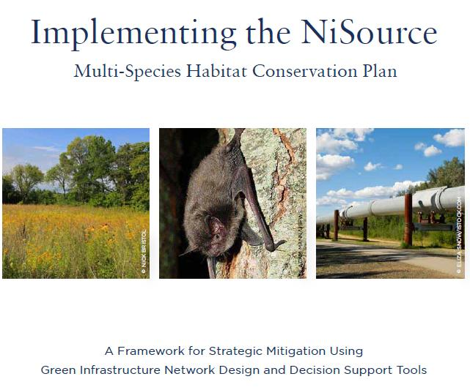

Application of Optimization in Conservation Settings
USDA’s Forest Legacy program
US Fish & Wildlife and NiSource – Largest multiple endangered species, multiple-state recovery program
US Military’s Readiness and Environmental Protection Initiative
Highway 301 near Waldorf, Maryland – Green Infrastructure
Maryland State Highways Association
Marsh habit for migratory birds in Delaware
Pennsylvania’s Dirt & Gravel Road Program
Trash and recycling program in Newark, Delaware
Halibut fisheries in Alaska
Agricultural preservation in Baltimore County, Maryland

Slide 26

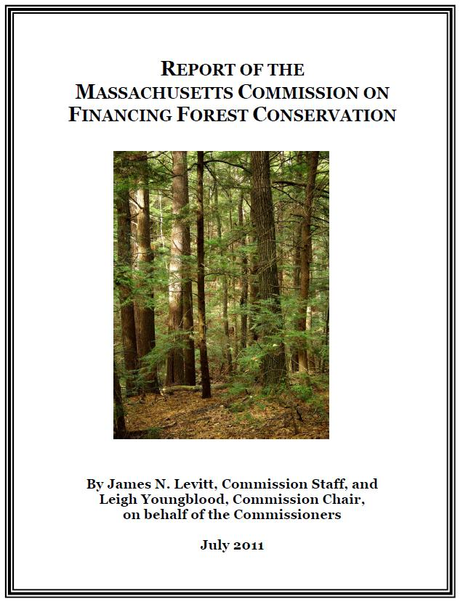
Endorsements & Obstacles
2013 survey of conservation professionals about optimization
87.3% of respondents believe that optimization is a good idea.
Most important criteria in selection process
Staff knowledge of process (4.1 on a 5-point scale)
Fairness to applications (4.0)
Transparency (4.0)
Cost Effectiveness (3.7)
Obstacles for adoption
Lack of incentives to justify a change (3.6 on a 5-point scale)
Good News
23% more likely to adopt optimization if they were given training and computer software to help implement optimization.
Thus, this important work continues…

Slide 27
